Slide 1

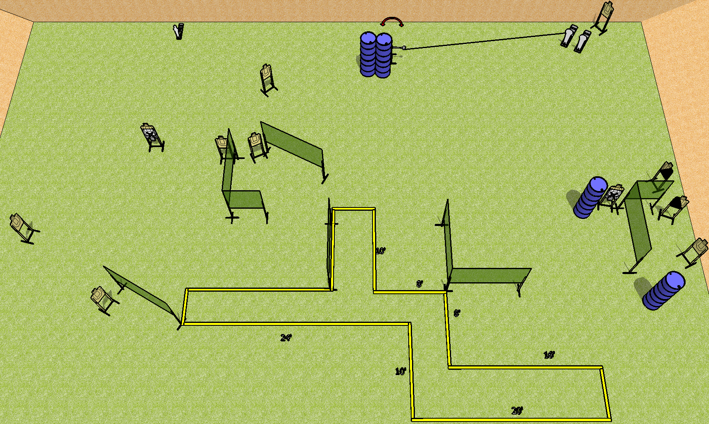
 | Dothan Practical Shooters – USPSA Match Hurried Course Designer : Drew Coleman Bay: A3
Round Count 27 rounds 12 USPSA 2 colt poppers, 1 mini popper
Equipment List 15 wall feet Swinger + activator 12 targets (10 + 2NS) 1 left + 1 right diag

Slide 2
Hurried
Written Stage Briefing
Scoring: Comstock Rounds: 27
Targets: 12 USPSA, 3 steel
Handgun start position: anywhere completely outside the shooting area, wrists below belt. Handgun is loaded and holstered.
PCC start position: anywhere completely outside the shooting area, stock on belt. Loaded carbine is held with both hands, safety on.
Stage Procedure: On the audible start signal, engage targets as they become available from within the shooting area. The swinger is activated by P2 and remains visible at rest.

